Slide 1
Housing Prediction
By,
Vijay Rodrigues

Slide 2
Problem Statement:
A US-based housing company named Surprise Housing has decided to enter the Australian market. The company uses
data analytics to purchase houses at a price below their actual values and flip them at a higher price. For the same
purpose, the company has collected a data set from the sale of houses in Australia. The data is provided in the CSV file
below.
The company is looking at prospective properties to buy houses to enter the market

Slide 3
EDA Steps / Data Pre-processing Done
Acquire the dataset
We have received this dataset from FlipRobo Technologies which is related to a Housing data company from US.
The sample data is provided to us from our client database. It is hereby given for this exercise. The customer wishes to get into Australian market based on US Housing model.

Slide 4
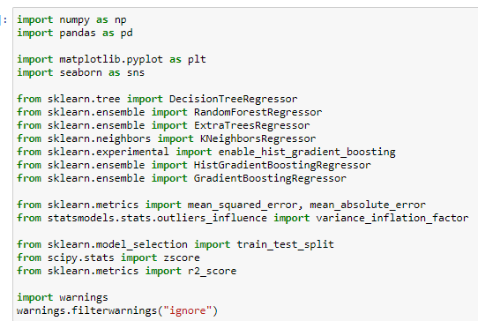
2. Import all the crucial libraries
For this project I have used the following major libraries like Pandas-profiling, Pandas, Matplotlib and Seaborn that are used for EDA or any other pre-processing done in this scenario.

Slide 5
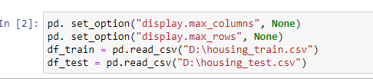
3. Import the dataset
The dataset is in CSV format and it is imported using Pandas library in Jupyter Notebook.
The statement pd. set_option("display.max_columns", None) simply allows us to physically see all the feature columns.
The statement pd. set_option("display.max_rows", None) simply allows us to physically see all the feature rows.
By default, Jupyter Notebook doesn’t display all the rows and columns at the same time and only selected portion from starting and ending of dataset are displayed.

Slide 6
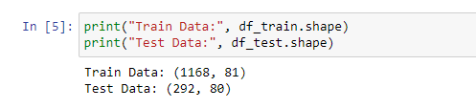
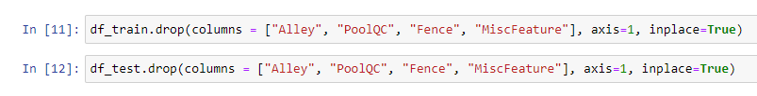
4. Identifying and handling the missing values
The dataset appears to have a total of 1460 records (rows) and 81 features (columns) including 1 target column "SalesPrice"
The following columns are dropped as there are more number of missing values than it could be replaced.

Slide 7
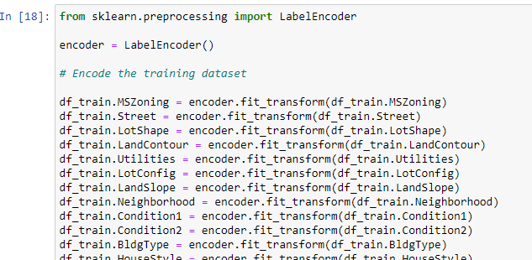
5. Encoding the categorical data
I have used LabelEncoder as the data is categorical and is not ordinal in nature.

Slide 8
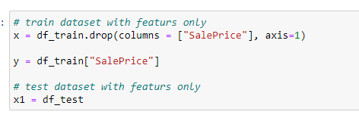
6. Splitting the dataset
Splitting up of dataset between x (features) and y (target column).
Split the dataset into train and test data set.
I have chosen 200 random state and 30% of data is divided in text dataset.

Slide 9
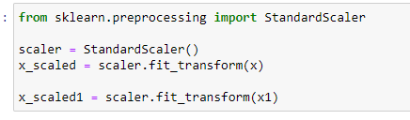
7. Feature scaling and Standardization
Finding variance inflation factor in each scaled column
This gives us relationship between feature vs feature and we can drop if necessary to avoid multicollinearity.
From the below observation, I have not considered this step.
Also without dropping the features I got even better accuracy in the final model.
Let’s us now Scale the data for further processing.
we have used StandardScaler for further scaling up of data

Slide 10
Assumptions considered
Data contains 1460 entries each having 81 variables.
Data contains Null values. You need to treat them using the domain knowledge and your own understanding.
Extensive EDA has to be performed to gain relationships of important variable and price.
Data contains numerical as well as categorical variable. You need to handle them accordingly.
You have to build Machine Learning models, apply regularization and determine the optimal values of HyperParameters.
you need to find important features which affect the price positively or negatively.
Two datasets are being provided to you (test.csv, train.csv). You will train on train.csv dataset and predict on
test.csv file.

Slide 11
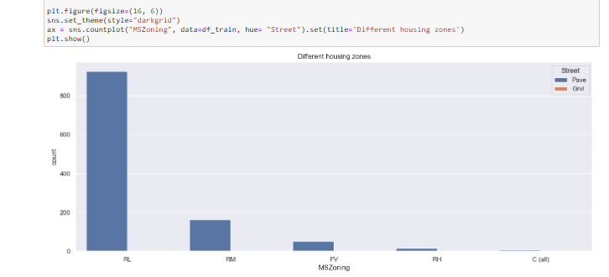
Visualizations
From the below plot we can identify the zoning area of the properties / apartments that are up for sale.
We can see from this plot that "RL" (Residential Low Density) areas are up for sale more than other zones.
The low thickness private zones are planned to make, keep up with, and advance neighbourhoods with bigger parcel sizes where the land use is fundamentally single-family abodes. They take into account some non household living uses however keep up with the general person of a solitary family area.
It makes sense as if the zones that fall in green belt or agriculture then using it for commercial purpose is not possible unless the land is infertile. This appears to be a large residential neighbourhood.

Slide 12
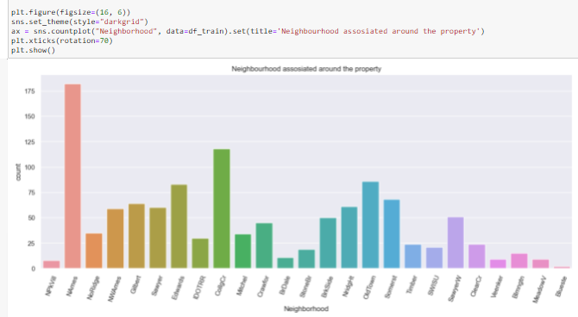
The below plot gives us idea on the locality of neighbourhood of the residences within Ames city limits.
Ames is a city in Story County, Iowa, United States and the properties belong to the "Northwest Ames" in majority followed by "College Creek" and these areas are also known to have given properties on rent, lease etc. which included both apartments and condos.
As per a couple of surveys, cost of living anywhere in USA above 100 points is considered expensive and Iowa's cost of living is 83.7 which includes all essentials like job, grocery, housing etc. This states that it's one of the most sought of place in the USA if budget friendly home is a priority.

Slide 13
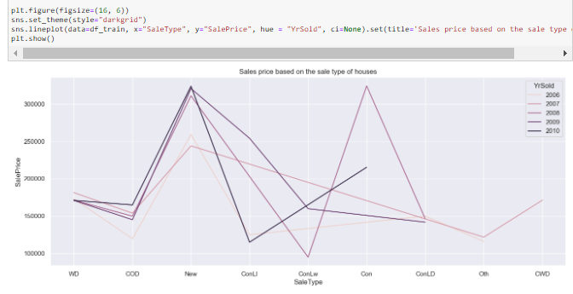
Let's observe if there is any relation between sales price of the properties over the years.
We can see that majority of high property sales have occurred in the year 2010, especially if the properties are either "New" or if it's on a Contract 15% Down payment regular terms.
A such a down payment is possible if the person looking forward to purchase has a steady income.
Higher the down payment, better the loan rates and since cost of living is so important. This could be an ideal option for people who cannot afford or do not wish to spend all at once.
We can also see the sales prices although less for the year 2007 when compared now, it was highest for that period of time. This shows how real estate’s values have increased over period of time for certain type of properties all over Iowa.

Slide 14
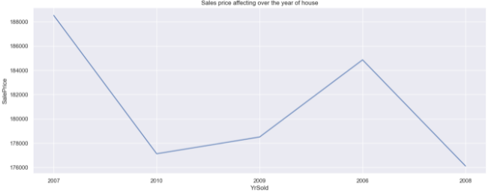
The below plot shows us the years when properties were sold the highest.
And it appears in the year 2006 and 2007 sales were high but gradually decreased in the year 2008 until 2010.
The monetary emergency of 2007-2008 was a very long time really taking shape.
By the late spring of 2007, monetary business sectors all throughout the planet were giving indications that the retribution was late for quite some time long gorge on modest credit.

Slide 15
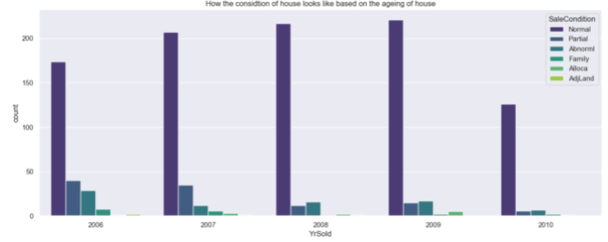
We can see from the below plot that thought the years only "Normal sales" houses were bought compared to already existing.
Customers did not seem to go for options like trade, foreclosure, short sale or sale between families and seldom preferred houses that were partially unfinished.
This is a clear indication that when a person gets on a market price without middleman or brokers customers tend to get direct and better deals thus saving money to some extent.
Also, in general people prefer buying houses that are pose less threat and hassles, means less and concrete paperwork’s, easier way of getting loans for houses which seems ideal when going with Normal Sales compared to other type of sales conditions.

Slide 16
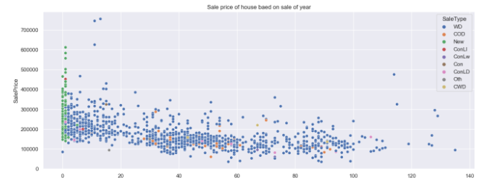
An assurance deed is a kind of deed where the grantor (seller) guarantees that the person being referred to holds clear title to a real estate parcel and has a choice to bring to the table it to the grantee (buyer), instead of a quitclaim deed, where the vendor doesn't guarantee that the individual holds title to a land parcel.
An assurance deed is a record routinely used in land that gives the best proportion of protection to the purchaser of the property. The deed pledges or warrants that the owner cases the property totally free in regards to any exceptional liens, contracts, or various encumbrances
It appears Warranty Deed seems to be the most sought-after payment or purchasing method as it's clearly in favour of both the parties as and when the duration of built year and sale year increases.

Slide 17
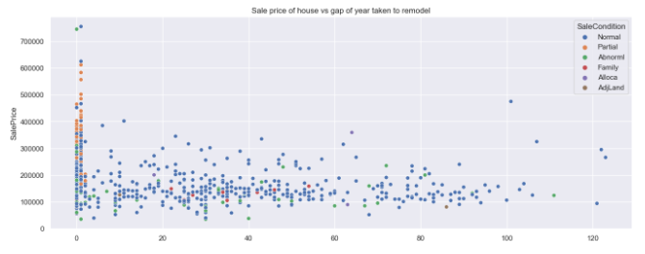
It appears from the below plot that number of years taken to remodel doesn't really seem to affect the sale type.
Apart from New, in such cases also people seem to prefer WD over other sale types. Hence in a way, both selling of properties with or without remodelling completely or to some extent doesn't really seem to affect the value.
Maybe because of abundance of properties across neighbourhood, a customer has multiple options to go with.
But if the house is newly built that has not completed i.e. partially completed, then only it seems to fetch good amount if remodelled as the market value doesn't seem to diminish the actual value.
This could be common amongst those who buy houses at a cheaper rate and rent it to other parties to get a potential and steady income.

Slide 18
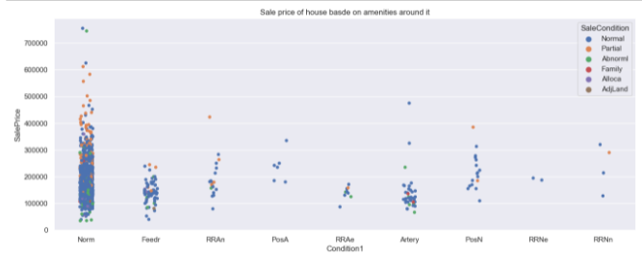
We can see that the roadways or streets seems to play an important role.
Houses / properties that are in neighbourhoods, condos, villa's etc fetch good number of values and if it was remodelled or partially completed it seems to get even higher sale to some extent.
But apart from these, customers may also prefer to go to areas that are near to roads, hence connectivity could be a key factor.
Properties near to feeder street ( inner / interior roads) and also on arterial street ( junction roads) are the second sought after properties and majority in all cases normal sale type is highly preferred.

Slide 19
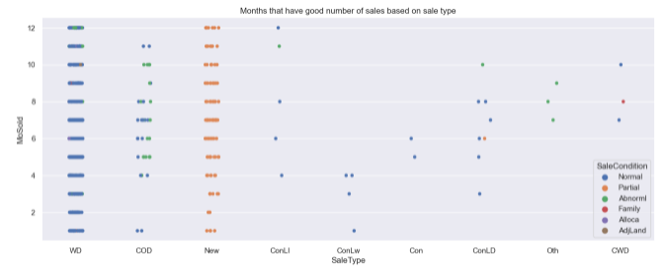
We can see from the below plot that "Warranty Deed" and "New" are favourable throughout the year and since it's a procedure, it doesn't really seem to be affected by months.
But we can see that apart from these options, people may also prefer "COD" (Court Officer Deed) and it seems to appear often between the months May to October.
Court Officer Deed - A deed where an agent or director of a home or a conservator of the property of a ward moves title for the benefit of a bequest or conservatorship. Court endorsement might be important before the State can acknowledge this sort of transport.

Slide 20
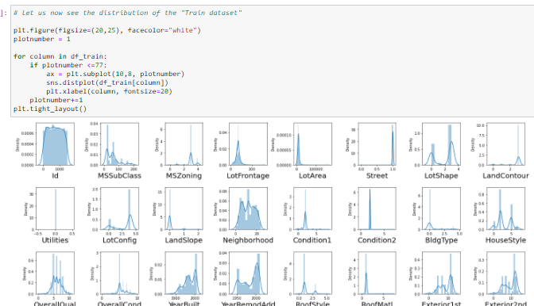
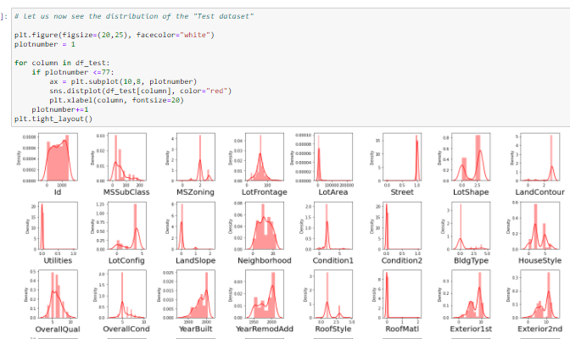
Distribution of both Train and Test dataset

Slide 21
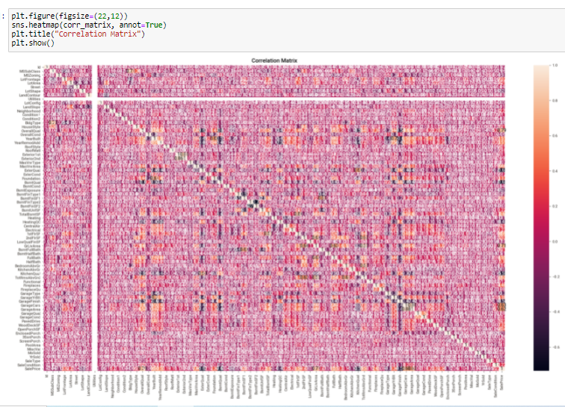
Let’s us now examine correlation using a "heatmap" for further clarification
Since there are multiple features, going through this plot may seem difficult.

Slide 22
For the model building I have considered the following 6 algorithms for the training and testing.
DecisionTreeRegressor
RandomForestRegressor
ExtraTreesRegressor
KNeighborsRegressor
HistGradientBoostingRegressor
GradientBoostingRegressor

Slide 23
Run and Evaluate selected models
I have used a total of 6 machine learning algorithms to find the best and suited model which also includes ensemble algorithms.
I have considered Adjusted R2 Score for model evaluation.
But we cannot simply rely on these scores as we cannot have any scope for assumption. Hence post this I have also performed Cross Validation for all these algorithms to find the estimated performance metric when it’s actually used in production.

Slide 24
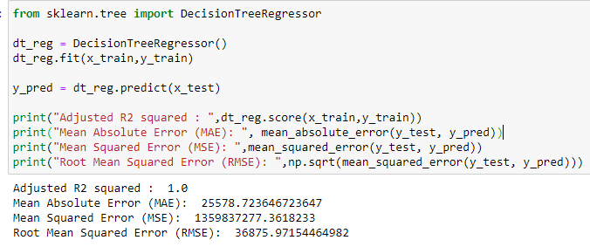
1) DecisionTreeRegressor
From the below algorithm we can see the accuracy score for DecisionTreeRegressor is approximately 100% better.

Slide 25
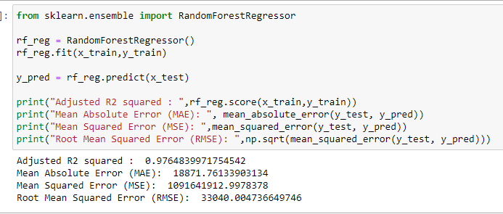
2) RandomForestRegressor
From the below algorithm we can see the accuracy score for RandomForestRegressor is approximately 97.64% better.

Slide 26
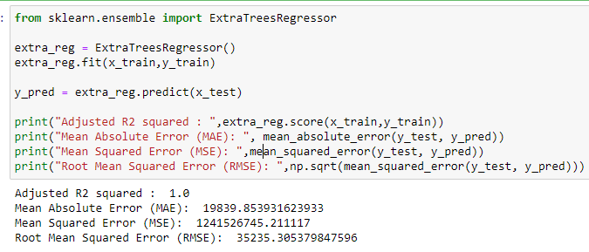
3) ExtraTreesRegressor
From the below algorithm we can see the accuracy score for ExtraTreesRegressor is approximately 100% better.

Slide 27
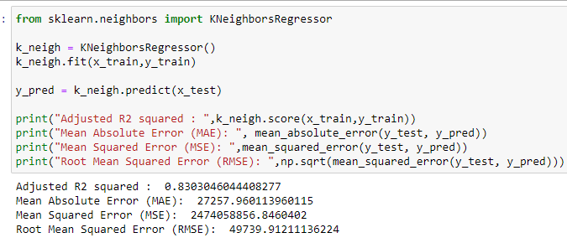
4) KNeighborsRegressor
From the below algorithm we can see the accuracy score for KNeighborsRegressor is approximately 94.49% better.

Slide 28
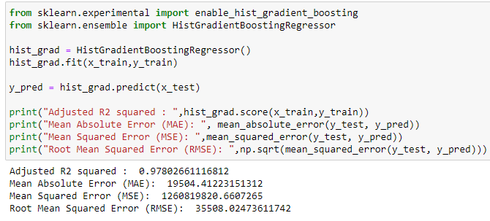
5) HistGradientBoostingREGFRESSOR
From the below algorithm we can see the accuracy score for HistGradientBoostingRegressor is approximately 97.80% better.

Slide 29
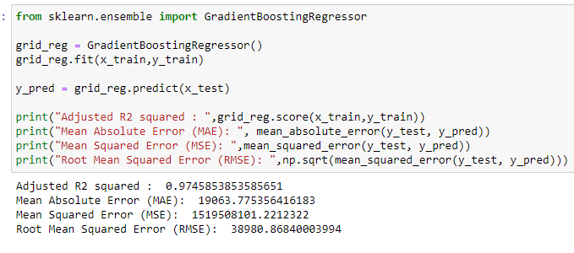
6) GradientBoostingRegressor
From the below algorithm we can see the accuracy score for GradientBoostingRegressor is approximately 97.45% better.

Slide 30
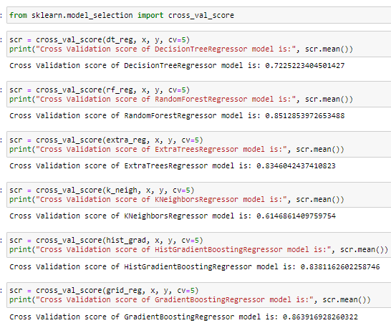
Cross Validation
The below code shows us the cross validation performed over all the algorithms and I have used the CV values as 5.
If you observe the below screenshot, we get the difference in the values.

Slide 31
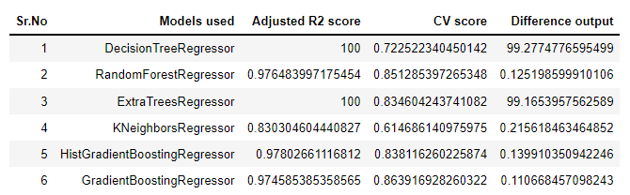
Model Selection
From the above algorithms GradientBoostingRegressor seems to be an ideal algorithm in this scenario and for this type of dataset.
The difference between the accuracy score and cross validation for this model is very less compared to other models.

Slide 32
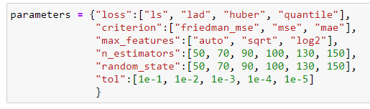
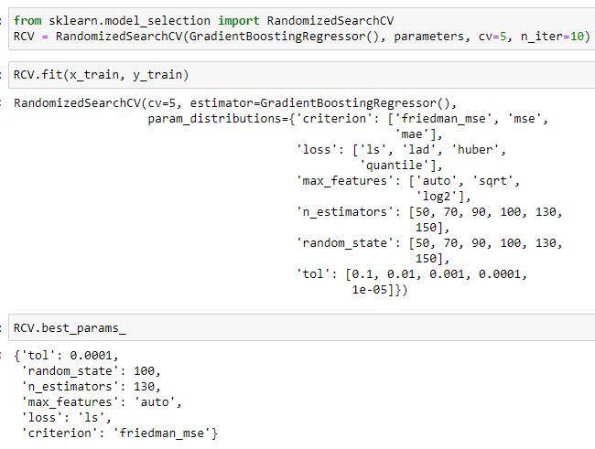
Hyperparameter Tuning
Let us try to tune the proposed model (GradientBoostingRegressor) to get better accuracy, if possible.
The "parameters" have been selected from the skicit library and I have considered 6 parameters.
RandomizedSearchCV is used to tune the parameters by fitting the same to the training dataset and used the best parameters after selection.

Slide 33
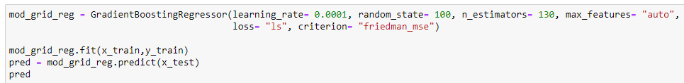
Final Model ( post Hyperparameter Tuning)
Rebuild the model using the appropriate params we received from best_params_

Slide 34
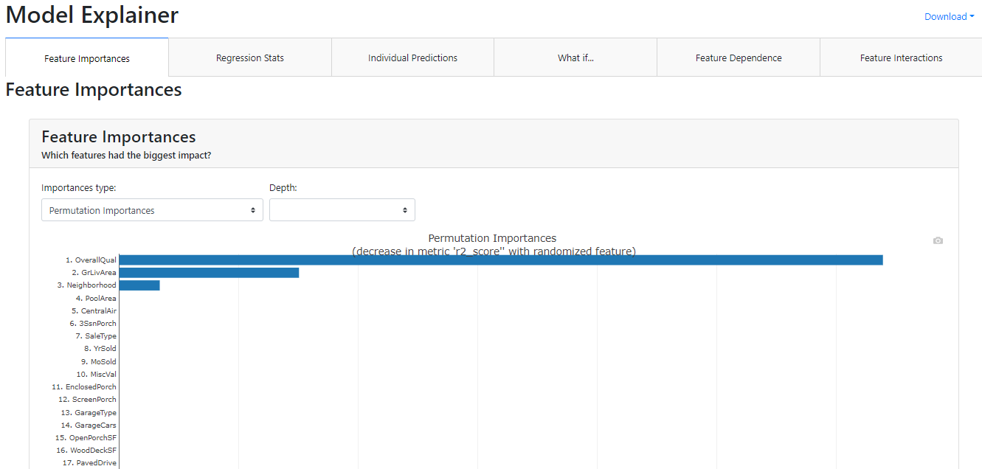
Model Dashboard
With the help of python library explainerdashboard I have managed to create a final model dashboard for your reference.

Slide 35
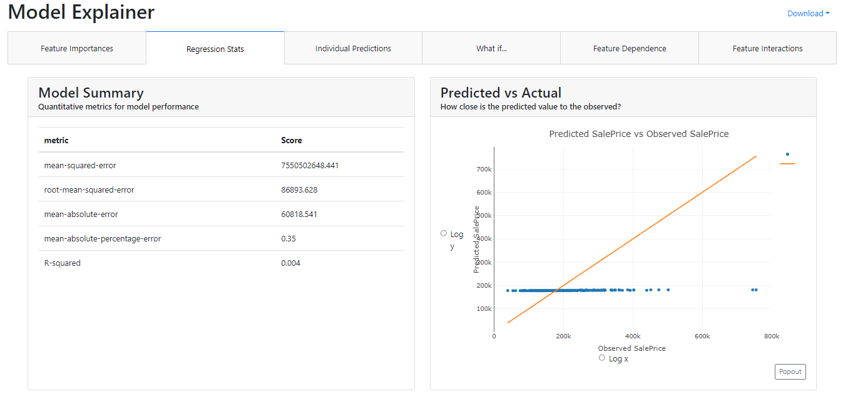
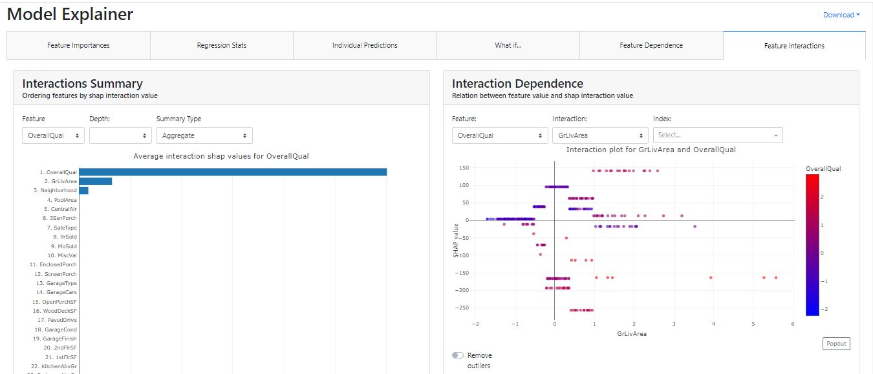
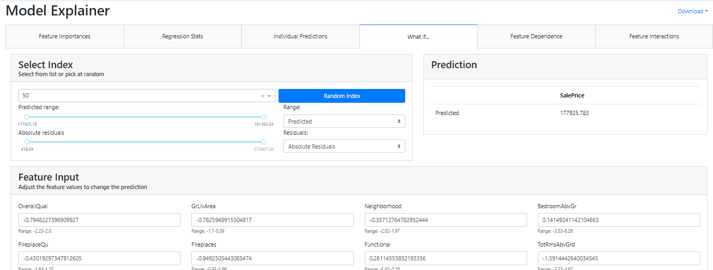

Slide 36
Learning Outcomes of the Study in respect of Data Science
With the help of this dataset, I was able to work on multiple regression algorithms and also got to work on real-world dataset.
The dashboard that I built using ExplainerDashbaord took me approximately 16 hours. This could be because I use older system and processing power is very less for such applications as the dataset is very small.

Slide 37
Limitations of this work and Scope for Future Work
Also, this dataset contains information only for past years and not current year and I believe having at least an annual information can help in formulating even better approaches.
The customer is looking forward to build / invest in housing in Australia and since the market is very different the predictions may vary dues to economic and other external factors.

Slide 38
Thank You…

